Slide 1
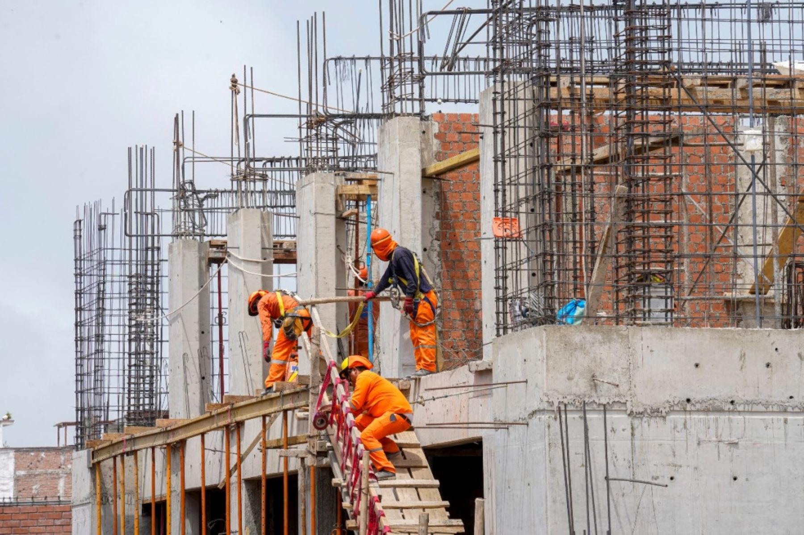

White Elephants Kill. Can we anticipate them?
Andrei Bartra and Angelo Cozzubo
CAPP 30254 – UChicago, Spring 2020

Slide 2
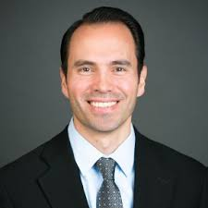

The Context and the Problem
Peruvian Miracle: high growth last 20 years
But infrastructure deficit ~$110 billions, one of the highest in Latin America (Latam)
Deep corruption problems
Ministry of Economics (MEF) faces delays and “ghost projects”
High opportunity cost
Peru with 3rd lowest tax burden in Latam
Guardians of accountability
RCT construction in Peru
Letters remembering the work was being monitored by civil organizations reduced its costs
White Elephants Kill
Study incomplete sewerage projects in Peru
Raise in under-5 mortality. Linked to risks of delayed or abandoned works
P. Lagunes - Columbia
A. Bancalari - LSE

Slide 3


Data Sources
Monthly Execution and Approval Characteristics
Public Investment Projects designated at the central or regional level with registered execution from 2012 to 2019
1
Administrative Data
Infrastructure Works, 2012 - 2019
Unit of analysis: Project and budget year
Ministry of Economics and Finance
More than 150 variables regarding share of population in region
Geography (~17 vars) Household (hh) members (~3 vars) HH characteristics (~40 vars) HH Income (~30 vars)
HH Health (~10 vars)
HH labor (~30 vars) HH ethnicity (~2 vars)
2
Living Standard Measurement Survey
ENAHO, 2012 - 2019
Aggregated and merged at regional level considering region where work is located
Peruvian National Institute of Statistics

Slide 4






Public Investment Projects Data
Project Proposals Data: Project level data with approval details
Proj. types: New, upgrade or Intangible
Key Words
Analyzed projects names and selected lists of key words strongly related to those categories
Jaro Winkler
Project Names had typos, so we performed fuzzy matching with Jaro-Winkler
Room for improvement!
Approved Amount
Total investment in the project at the time the proposal is accepted
Approval Date
Date the project was approved for budget

Slide 5

Public Investment Projects Data
Project Execution Data: Monthly execution at budget account level.
Government Level
Variables
Cumulative Execution of the Project (Target)
Cumulative Execution by category (money and ratio)
Execution Share by category
Yearly Budget
Economic
Sector
Funding
Source
Budget Office
Team Performance
Cumulative Execution of the Budget Office and cumulative Execution of the Execution Unit

Slide 6
Final Data Structure
$$Target= \frac{\sum_{jan}^{dec}{Execution}}{Year Budget}$$
Available data for each forecast
Blind Spot
Target
Observations: 814,632
Projects: 23,172
Years: 2012 – 2019
Initial Variables: 344
Example:

Slide 7
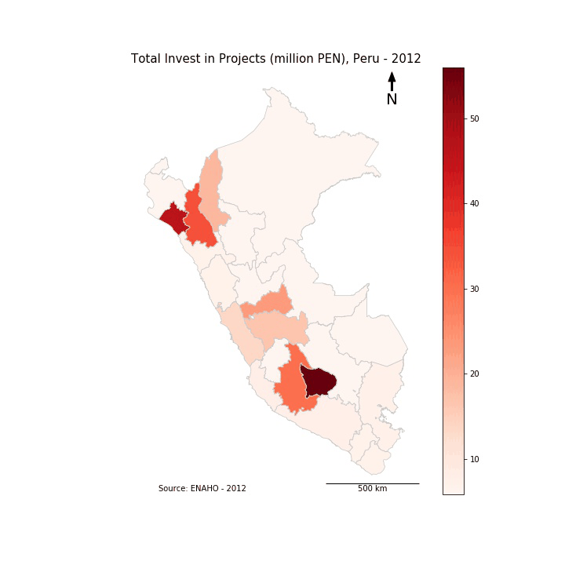
Descriptive Statistics (I) – Geographic Variation
Regional share of investment varies substantially
Important resources coming from local mining works
Initial years show investment focused on least developed regions
Recent increase in the overall investment

Slide 8
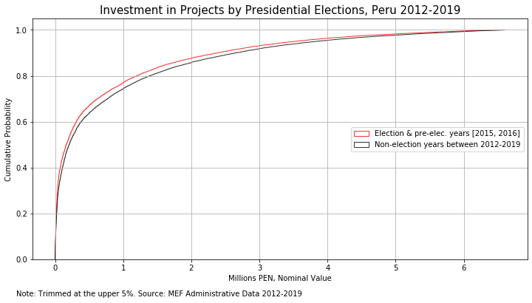
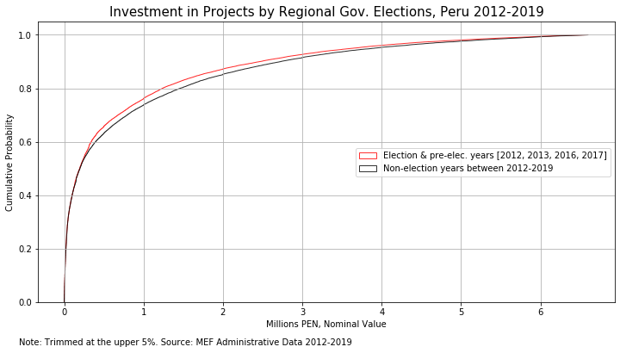

Descriptive Statistics (II) – Electoral Variation
Non-election years curve stochastically dominates election years curve
That is, in election & pre-elec. years smaller projects are preferred

Slide 9
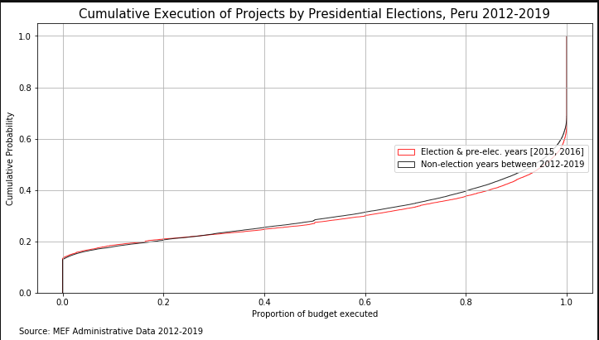
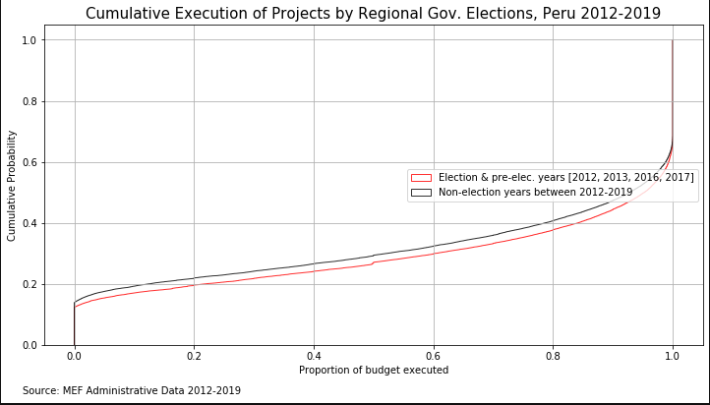

Data: Descriptive Statistics (III) – Target
Election years curve stochastically dominates the non-election years curve
That is, execution of projects is accelerated in election and pre-election years

Slide 10
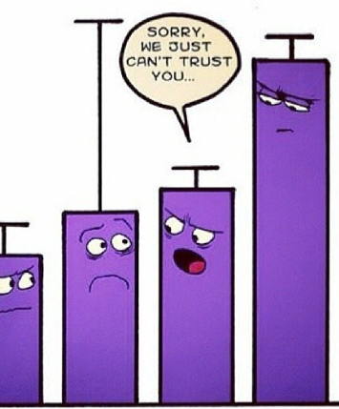

Machine Learning: Pre-processing
Missing Value
Continuous vars imputed with zero
Indicator dummy var for imputed rows
Outliers
Continuous trimmed upper 1%
Correlation Filter
Kept predictors lowly corr. with each other
Reduction of complexity
Imputed with the percentile 99 value
Unit of Analysis: Project-month level.

Slide 11
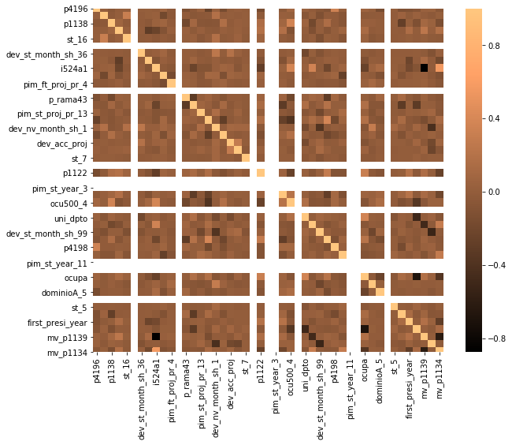
Machine Learning: Analysis
The algorithm for variable reduction selected a set of variables with low correlation

Slide 12
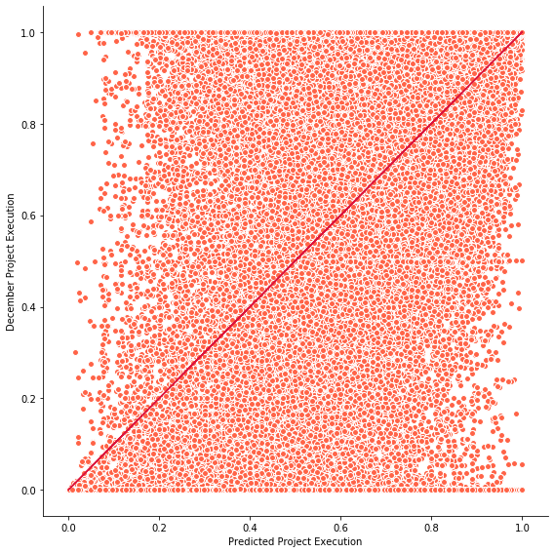
Machine Learning: Results (I)
Visually the model does not look good, but it has decent R2 Scores
R2 Train: 49.2%
R2 Test: 47.9%

Slide 13
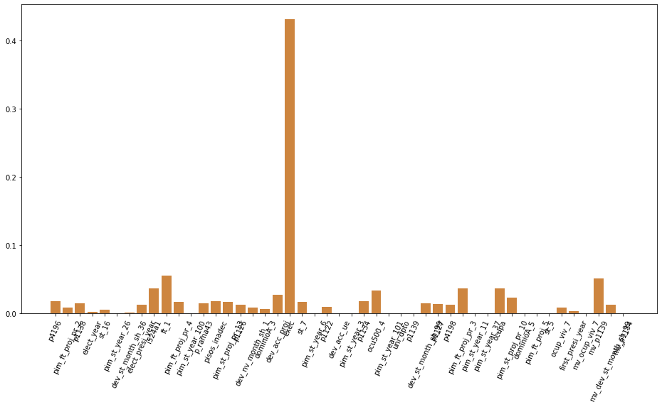
Machine Learning: Results (II)
The current execution is by the far the most important variable

Slide 14


Policy Recommendations
Efficiency on the budget Allocation
Quick glance to all project portfolio
Make quick systematic decisions
Add information for a one-to-one or field analysis
Early warnings to intervene projects with high probability of not meeting the execution goal

Slide 15
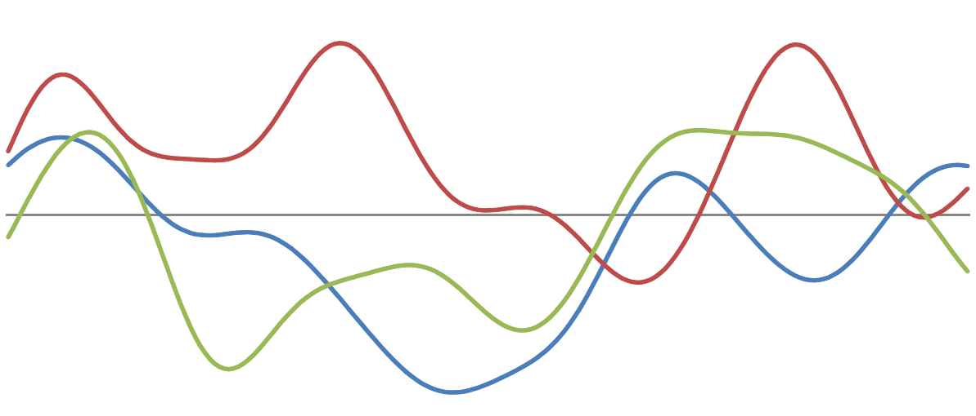

Next Steps
Apply time-series operators:
Minimum, Maximum, Average, Count from the last 3, 6 and 9 months.
Everything lagged one year.
Improve sample space
At the moment, the model can not make forecasts on January. Using time-series operators, January may consider information from last year.
Polynomial Expansions: Square, Log Model Tunning: GridSearchCV

Slide 16


Limitations and Agenda
Time constraints
Better cluster techniques on budget offices and Economic Sectors
Supervised model for the classification of new, upgrade or intangible project can be improved with a supervised model
More time-series operators: time-beta, moving averages differences, among others
Several data sources are not being taken into account due to the time-consuming process of cleaning and processing the data.

Slide 17

White Elephants Kill. Can we anticipate them?
github/….

